Slide 1




Slide 2

REMAINDER THEOREM

Slide 3
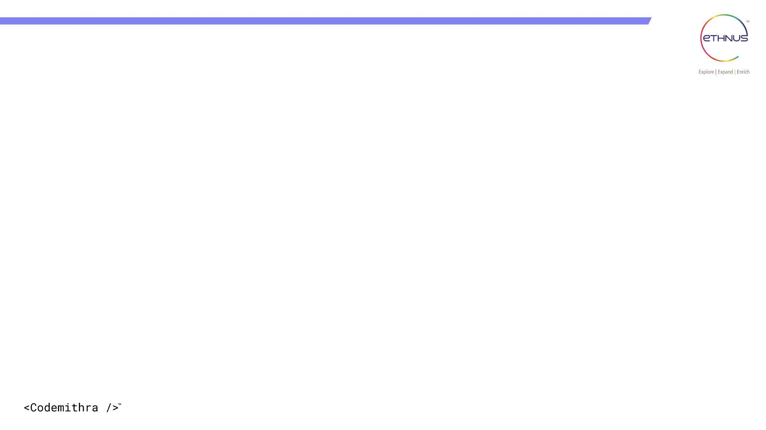

TOPICS
Explanation
Coding
Interview Questions
Practice Questions

Slide 4
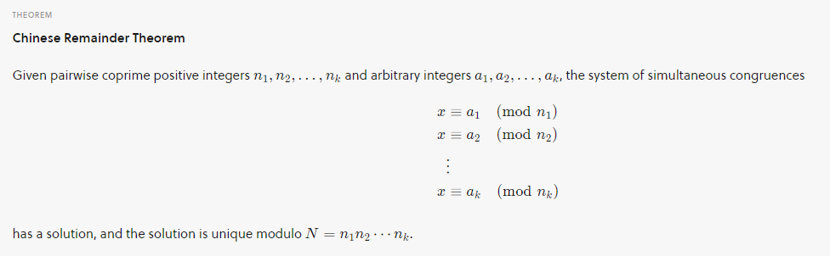
Remainder Theorem
Basically, we are given k numbers which are pairwise coprime, and given remainders of these numbers when an unknown number x is divided by them.
We need to find the minimum possible value of x that produces given remainders.
Chinese Remainder Theorem states that there always exists an x that satisfies given congruences
Let nums = [n1, n2, n3... nk] and rems= [a1, a2, a3...ak]. Then, for any given sequence of integers rem[0], rem[1], … rem[k-1], there exists an integer x solving the following system of simultaneous congruences.

Slide 5
Program
Sample IO
Input
num= [5, 7]
rem = [1, 3]
Output
31
Explanation
31 is the smallest number such that:
(1) When we divide it by 5, we get remainder 1.
(2) When we divide it by 7, we get remainder 3.

Slide 6
Program
Input
num= [3, 4, 5]
rem = [2, 3, 1]
Output
11
Explanation
11 is the smallest number such that:
(1) When we divide it by 3, we get remainder 2.
(2) When we divide it by 4, we get remainder 3.
(3) When we divide it by 5, we get remainder 1.

Slide 7
Program
import java.io.*;
import java.util.*;
class Main {
static int findMinX(int num[], int rem[], int k) {
int x = 1;
while (true) {
int j;
for (j = 0; j < k; j++) {
if (x % num[j] != rem[j]) {
break;
}
}
if (j == k) {
return x;
}
x++;
}
}

Slide 8
public static void main(String args[]) {
Scanner sc = new Scanner(System.in);
System.out.println("Enter the number of congruence relations: ");
int size = sc.nextInt();
int a[] = new int[size];
int m[] = new int[size];
System.out.println("Enter the values of a: ");
for (int i = 0; i < size; i++) {
a[i] = sc.nextInt();
}
System.out.println("Enter the values of m: ");
for (int i = 0; i < size; i++) {
m[i] = sc.nextInt();
}
System.out.println("x is " + findMinX(m, a, size));
}
}

Slide 9
LOGIC
1. Iterate through possible values of `x`:
The code starts with `x = 1` and increments it until a value is found that satisfies all the congruence relations.
2. Check if `x` satisfies all congruence relations:
For each iteration of `x`, the code checks if `x` satisfies all the congruence relations by checking if the remainder of `x` divided by each modulus is equal to the corresponding remainder.
3. Return the minimum `x` that satisfies all congruence relations:
If `x` satisfies all the congruence relations, the code returns that value as the minimum positive integer `x`.

Slide 10
import java.util.*;
class Main {
static int CRT(int a[], int m[], int n, int p) {
int x = 0;
for (int i = 0; i < n; i++) {
int M = p / m[i];
int y = 0;
for (int j = 0; j < m[i]; j++) {
if ((M * j) % m[i] == 1) {
y = j;
break;
}
}
x = x + a[i] * M * y;
}
return x % p;
}

Slide 11
public static void main(String args[]) {
Scanner sc = new Scanner(System.in);
System.out.println("Enter the number of congruence relations: ");
int size = sc.nextInt();
int a[] = new int[size];
System.out.println("Enter the values of a (remainders): ");
for (int i = 0; i < size; i++) {
a[i] = sc.nextInt();
}
int m[] = new int[size];
int p = 1;
System.out.println("Enter the values of m (moduli): ");
for (int i = 0; i < size; i++) {
m[i] = sc.nextInt();
p = p * m[i];
}
System.out.println("The solution is " + CRT(a, m, size, p));
}
}

Slide 12
LOGIC
1. Collect Input: Read the number of congruence relations, remainders `a`, and moduli `m`; calculate the product `p` of all moduli.
2. Calculate Solution Using CRT: For each congruence, compute the partial product `M`, find its modular inverse `y`, and accumulate the result `x` using ( x += a[i] times M times y ).
3. Output Result: Return the smallest positive solution by computing `x % p` and print the result.

Slide 13
INTERVIEW QUESTIONS

Slide 14
Interview questions
1. What is the Remainder Theorem?
The Remainder Theorem states that if a polynomial `f(x)` is divided by `x-a`, the remainder is `f(a)`.

Slide 15
Interview questions
2. How do you apply the Remainder Theorem?
The Remainder Theorem is used to find the remainder when a polynomial is divided by a linear factor. It is particularly useful in finding the remainder when a polynomial is divided by a linear factor that is not easily factorable.

Slide 16
Interview questions
3. What are some common applications of the Remainder Theorem?
The Remainder Theorem has various applications in computer science, such as in algorithms for polynomial division and in the construction of error-correcting codes.

Slide 17
Interview questions
4. How do you use the Remainder Theorem in coding?
The Remainder Theorem is used in coding to ensure that a polynomial is divided by a linear factor without having to perform the full division. This can significantly improve the efficiency of algorithms.

Slide 18
Practice Questions
Question 1:Write a function that takes two integers as input, "dividend" and "divisor", and returns the remainder when "dividend" is divided by "divisor".
Input:
Two integers: "dividend" and "divisor" (where "divisor" is not zero).
Output:
An integer representing the remainder.
Example:
Input: dividend = 10, divisor = 3
Output: 1
Input: dividend = 17, divisor = 5
Output: 2

Slide 19
Practice Questions
Question 2:Given a list of integers "nums" and an integer "divisor", write a function to count the number of elements in "nums" that are divisible by "divisor".
Input:
A list of integers: "nums".
An integer: "divisor" (where "divisor" is not zero).
Output:
An integer representing the count of elements in "nums" that are divisible by "divisor".
Example:
Input: nums = [4, 7, 10, 15, 20], divisor = 5
Output: 2
Input: nums = [12, 15, 20, 25], divisor = 7
Output: 1

Slide 20
Practice Questions
Question 3:Write a function to find the remainder of the polynomial expression "ax^2 + bx + c" when divided by a given divisor "d".
Input:
Three integers: "a", "b", and "c", representing the coefficients of the polynomial.
An integer: "d" (where "d" is not zero).
Output:
An integer representing the remainder.
Example:
Input: a = 2, b = 3, c = 5, d = 4
Output: 1
Input: a = 1, b = 4, c = 3, d = 2
Output: 1

Slide 21
Practice Questions
Question 4:Given a list of integers "nums", write a function to find the remainder of each element when divided by a given divisor "d".
Input:
A list of integers: "nums".
An integer: "d" (where "d" is not zero).
Output:
A list of integers representing the remainders.
Example:
Input: nums = [10, 15, 21, 24], d = 7
Output: [3, 1, 0, 3]
Input: nums = [12, 18, 27, 32], d = 5
Output: [2, 3, 2, 2]

Slide 22




THANK YOU
+91 78150 95095
codemithra@ethnus.com
www.codemithra.com

